Slide 1
tkinter and OOL
Marcin Skurczyński
Introduction to Programming for Business

Slide 2
How to run Idle
Find a python folder : c:\Python27
Windows+R “cmd”
Type: c:\python27\pythonw.exe “c:\python27\lib\idlelib\idle.pyw”

Slide 3
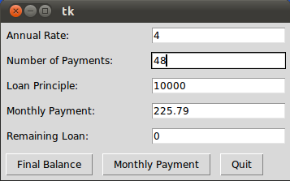

Slide 4
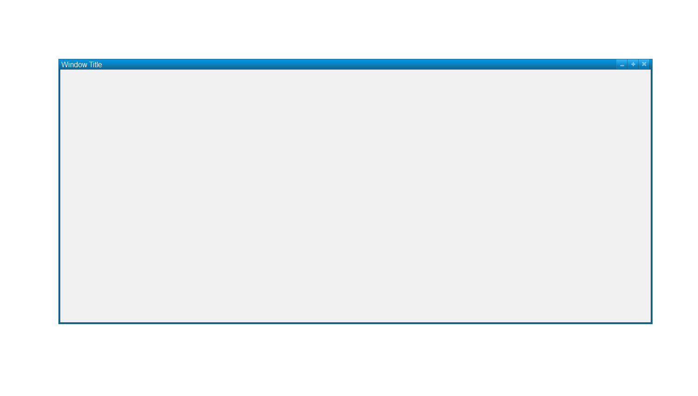
Presentation layer
newWindow = Tkinter.Tk()
Atrributes?
Dimensions
Colors
Fonts
Anchors
Relief styles
Bitmaps
Cursors
newWindow.wm_title(Window Title')
newWindow["width"] = 1000
newWindow["height"] = 500

Slide 5
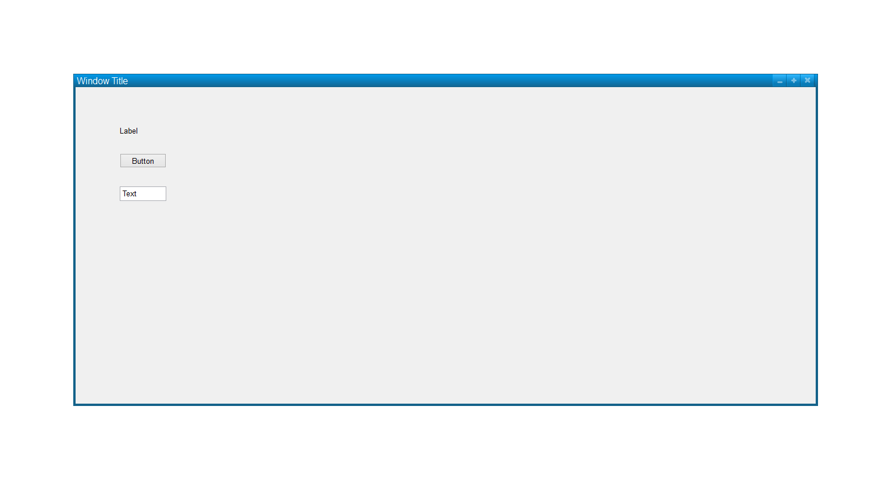
Widgets
newWindow = Tkinter.Tk()
Button
Canvas
Checkbutton
Entry
Frame
Label
Listbox
Menubutton
.
.
.

Slide 6
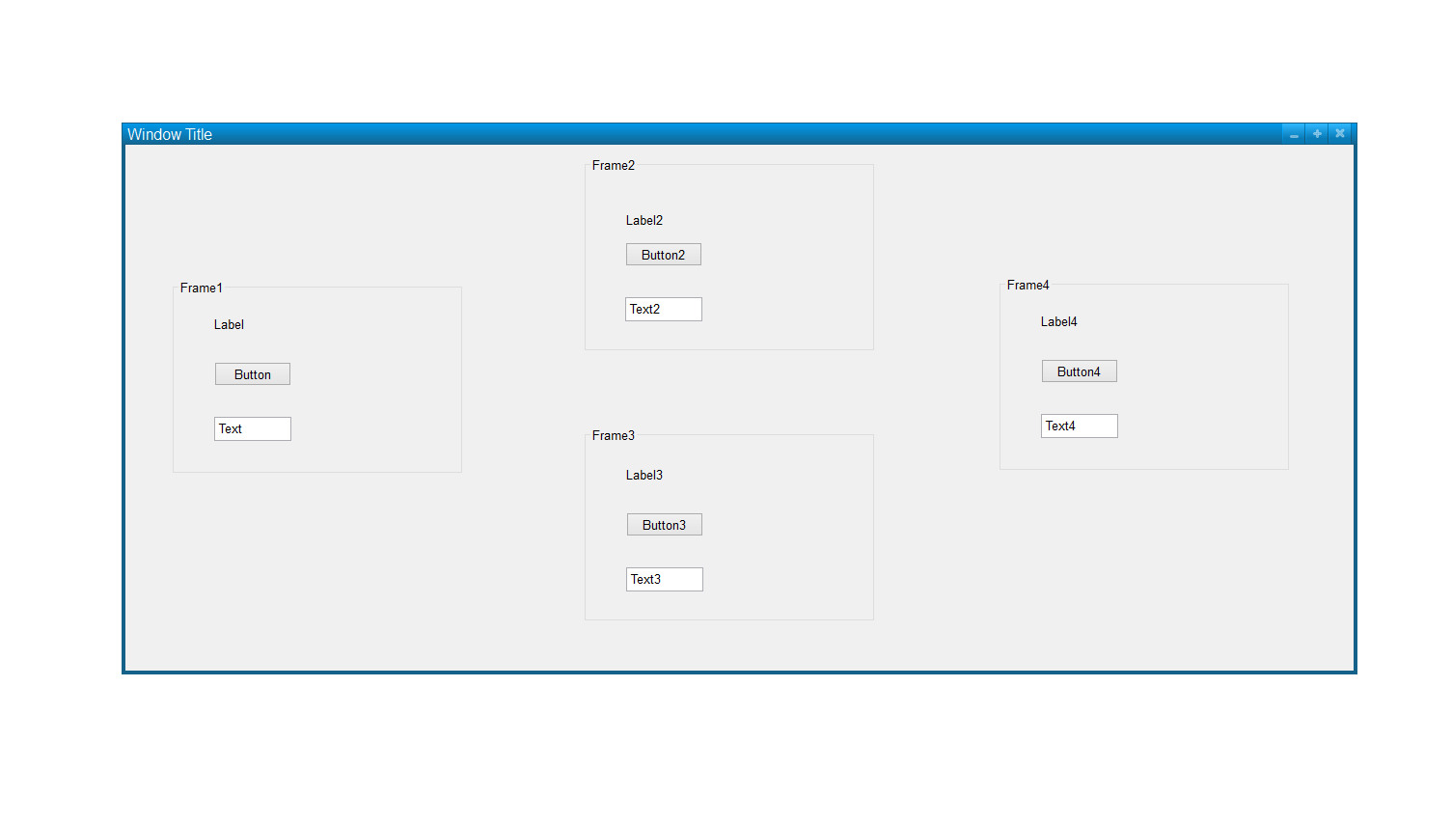
newWindow = Tkinter.Tk()
BELONGS TO
Frame1 = Frame(newWindow)
BELONGS TO
Button2 = Button(Frame1, text="Red", fg="red")

Slide 7
Layout
Object.pack(options)
Object.grid(options)
Object.place(options)

Slide 8
Go to: https://www.tutorialspoint.com/python/python_gui_programming.htm (and subpages – follow the links from the page)
Read the manual, try to:
Create a window
Add Buttons, Labels, Menus and/or other components
Design a layout of your choice – use your imagination!
Add some functionality – e.q.:
Add Button
Set its label to „Close”
Make it close the application
Add other functionalities too!

Slide 9
OOP – Object Oriented Programming
Everything is an object
Every object has attributes
Every object offers methods
ex.: A student: what attributes apply? What methods?

Slide 10
Defining a class
class Student:
def __init__(self, name, indexNo, studyAvg = 0):
self.name = name
self.indexNo = indexNo
self.studyAvg = studyAvg
def setAvg(self, avg):
self.studyAvg = avg
def getAvg(self):
return self.studyAvg
def __str__(self):
return self.name + ", Index No. „ + str(self.indexNo) + ", Study avg: " + str(self.studyAvg)
ali = Student("Kowalski", 12345)
print(ali)

